Slide 1
CSE322
Finite Automata
Lecture #2

Slide 2
Topics
Acceptability of a String by a Finite Automaton
Transition Graph and Properties of Transition Functions

Slide 3
Finite Automaton
Input
String
Output
“Accept”
or
“Reject”
Finite
Automaton

Slide 4









Transition Graph
initial
state
accepting
state
transition
state

Slide 5
Initial Configuration
Input String

Slide 6
Reading the Input

Slide 10
Input finished
accept

Slide 11
Rejection

Slide 15
Input finished
reject

Slide 16

Another Rejection

Slide 17
reject

Slide 18
Another Example

Slide 22
Input finished
accept

Slide 23
Rejection Example

Slide 27
Input finished
reject

Slide 28

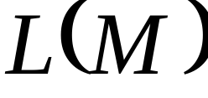

Languages Accepted by FAs
FA
Definition:
  The language contains
  all input strings accepted by
  = { strings that bring
  to an accepting state}

Slide 29
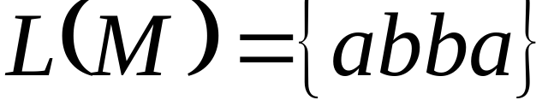
accept

Slide 30
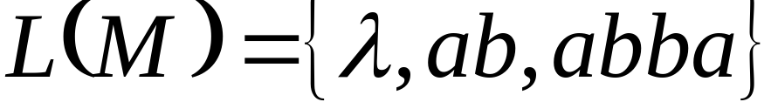
Example
accept
accept
accept

Slide 31
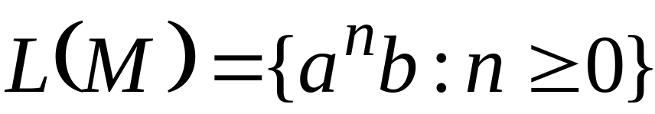
Example
accept
trap state

Slide 32

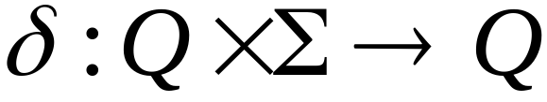
Transition Function

Slide 33
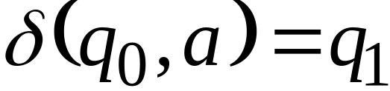

Slide 34
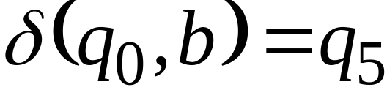

Slide 35
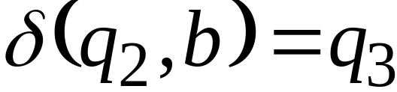

Slide 36


Transition Function

Slide 37


Extended Transition Function

Slide 38
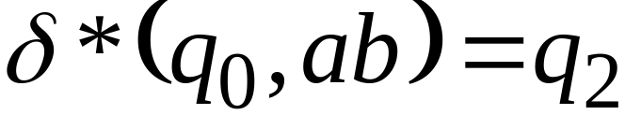

Slide 39
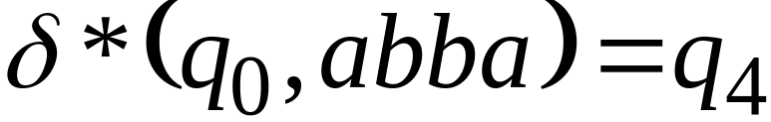

Slide 40
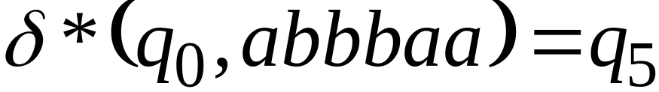

Slide 41
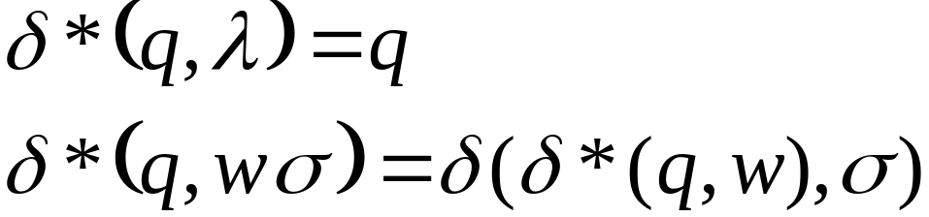





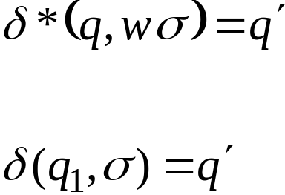
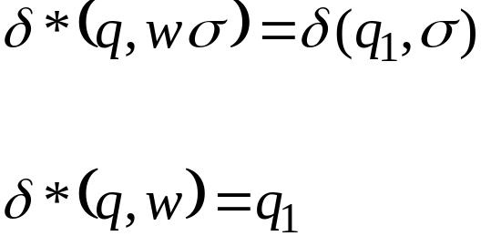

Recursive Definition

Slide 42
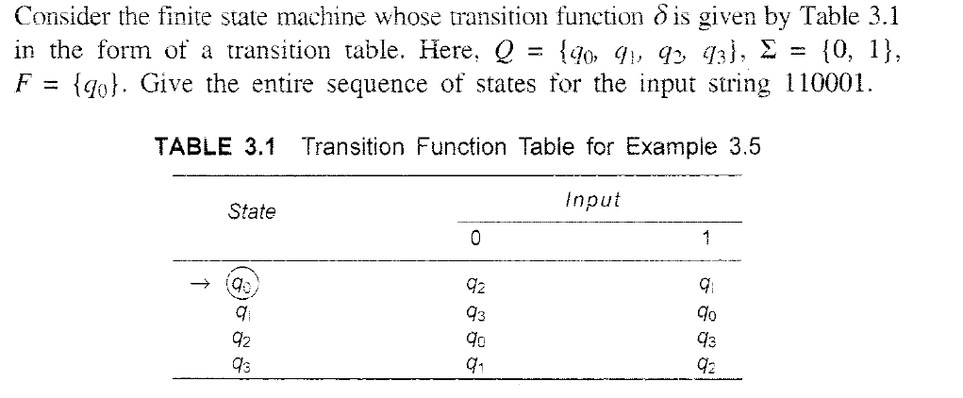

Slide 43
